Slide 1

Department of Computer and Information Science,
School of Science, IUPUI
CSCI 230
Introduction to Computers
- Hardware
Dale Roberts, Lecturer
Computer Science, IUPUI
E-mail: droberts@cs.iupui.edu

Slide 2


What is a Computer?
Computer
  Device capable of performing computations and making logical decisions
  Computers process data under the control of sets of instructions called computer programs
  Personal computers: economical enough for individual
  Distributed computing: computing distributed over networks
  Client/server computing: sharing of information across computer networks between file servers and clients (personal computers)
Dale Roberts

Slide 3
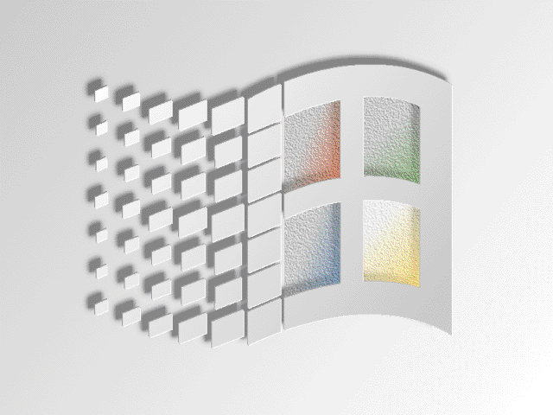


What is a Computer? (cont.)
Computer Hardware
  Various devices comprising a computer:
  Keyboard, screen, mouse, disks, memory, CD-ROM, and processing units
  Hardware Trends: every year or two the following approximately double (Moore’s Law):
    Amount of memory in which to execute programs
    Amount of secondary storage (such as disk storage)
      Used to hold programs and data over the longer term
    Processor speeds
      The speeds at which computers execute their programs
User
Application
Software
High-level
Language
Assembly
Language
Firmware
Machine
Code
OS
Hardware

Slide 4
What is a Computer? (cont.)
Computer Software
  Computer Programs that run on a computer, including
    Operation System (OS)
    Application Software
    Computer Language
User
Application
Software
High-level
Language
Assembly
Language
Firmware
Machine
Code
OS
Hardware

Slide 5

Moore's Law
Defined by Dr. Gordon Moore during the sixties.
Predicts an exponential increase in component density over time, with a doubling time of 18 months.
Applicable to microprocessors, DRAMs , DSPs and other microelectronics.
Monotonic increase in density observed since the 1960s.

Slide 6
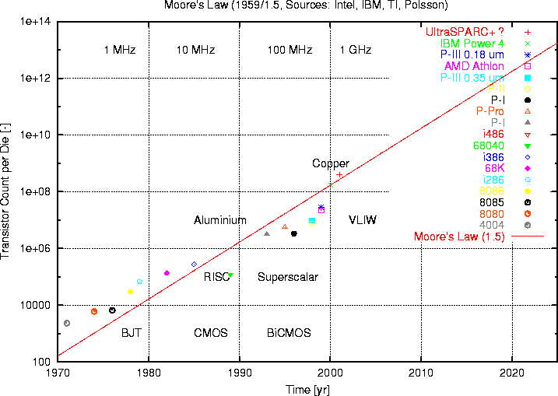
Moore’s Law - Density

Slide 7
Moore's Law and Performance
The performance of computers is determined by architecture and clock speed.
Clock speed doubles over a 3 year period due to the scaling laws on chip.
Processors using identical or similar architectures gain performance directly as a function of Moore's Law.
Improvements in internal architecture can yield better gains than predicted by Moore's Law.

Slide 8
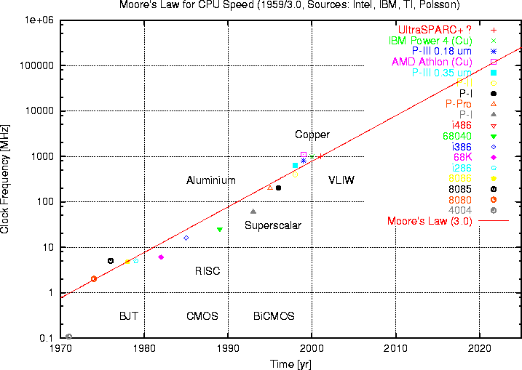
Moore’s Law - Clock Speed

Slide 9


What is a Computer? (cont.)
Internet
  The Internet enables
    Quick and easy communication via e-mail
    International networking of computers
  Packet switching
    The transfer of digital data via small packets
    Allows multiple users to send and receive data simultaneously
  No centralized control
    If one part of the Internet fails, other parts can still operate
  Bandwidth
    Information carrying capacity of communications lines
    Ex: Internet T2 at IUPUI
  World Wide Web
    Locate and view multimedia-based documents on almost any subject
    Makes information instantly and conveniently accessible worldwide
    Possible for individuals and small businesses to get worldwide exposure
    Changing the way business is done

Slide 10
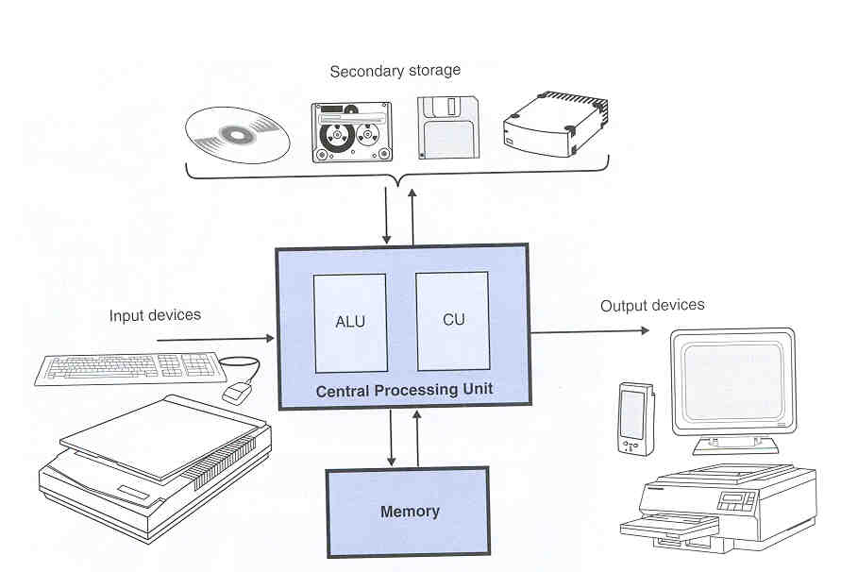
Computer Organization
A Typical Von-Neumann Architecture
  Example:
  Input unit
  Output unit
  Memory unit
  Arithmetic and logic unit (ALU)
  Central processing unit (CPU)
  Secondary storage unit
CPU
Control Circuit
(ex: PC: Program Counter)
Memory
I/O
ALU

Slide 11
Computer Organization (cont.)
Six logical units in every computer:
  Input unit
    Obtains information from input devices (keyboard, mouse)
  Output unit
    Outputs information (to screen, to printer, to control other devices)
  Memory unit
    Rapid access, low capacity, stores input information
    ROM (Read Only Memory): CMOS, EPROM …
    RAM (Random Access Memory): SRAM, DRAM, SIMM, DIMM …

Slide 12
Computer Organization (cont.)
  Six logical units in every computer (cont):
  Arithmetic and logic unit (ALU) – part of CPU
    Performs arithmetic calculations (addition, subtraction...) and logic decisions
  Control unit (CU) - part of CPU
    Supervises and coordinates the other sections of the computer
  Secondary storage unit
    Cheap, long-term, high-capacity storage
    Stores inactive programs

Slide 13
Computer Organization (cont.)
Central Processing Unit (CPU),
  “brain” of a computer, consisting of
    Arithmetic and logic unit (ALU): performs arithmetic calculations (addition, subtraction...) and logic decisions (>, <, =, ...)
    Control Unit (CU): decodes each machine instruction and sends signal to other components for carrying out the instruction.
  An integrated circuit (IC) that is a full central processing unit is called a microprocessor (μp); a CPU’s current instruction and data values are stored temporally inside the CPU in special high-speed memory location called registers.
  CPU speed: ? MHz (M: Mega = 10⁶, Hz=1/sec);

Slide 14


Computer Organization (cont.)
Memory
  A large collection of circuits, each capable of storing bit
  Cells (words): manageable units; typical size is 8 bits (1 byte), some machines are 16 bits (2 bytes) and some are 32 bits or 64 bits
    Byte (8 bits), KB (kilobyte, 10³ ≈ 2¹⁰ bytes), MB (Megabyte, 10⁶ ≈ 2²⁰ bytes), GB (Gigabyte, 10⁹ ≈ 2³⁰ bytes). Note: k ≠ K because 1000 ≠ 1024.

Slide 15
Computer Organization (cont.)
  Computer memory is comparable to a collection of numbered mailboxes. To identify individual cells in a machine’s main memory, each cell is assigned a unique name, called its address
  The organization of byte-size memory cell
ASCII
H
e
l
l
o
,
...
...
Data
01001000
01100101
01101100
01101100
01101111
00101110
Address
0000 0101
0000 0110
0000 0111
0000 1000
0001 0001
0001 0010
Address Bus
Data Bus
Most Significant Bit (MSB)
Least Significant Bit (LSB)
High-order end
0 0 0 0 0 1 0 1
Low-order end

Slide 16
Acknowledgements
Moore’s Law: Kopp, Carlo. Monash University. Melbourne, Australia. 2000.

